Slide 1
APUSH Review: “Old Immigration” and Nativism
Everything You Need To Know About Old Immigration and Nativism To Succeed In APUSH

Slide 2

What is “Old Immigration?”
What is it?
Immigrants that came from Northern and Western Europe
Specific countries?
Ireland, Germany, England
When did it occur?
1820s – 1870s
What group made up the largest prior to the Civil War?
Irish

Slide 3
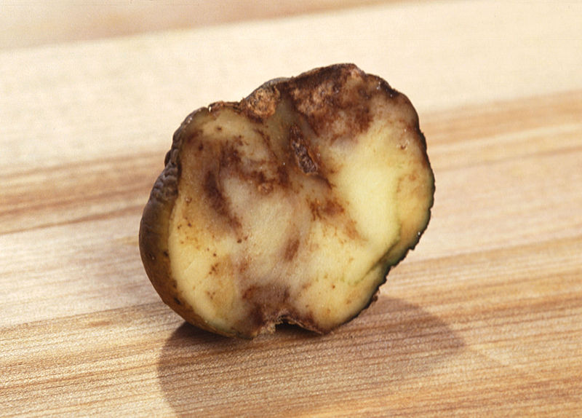
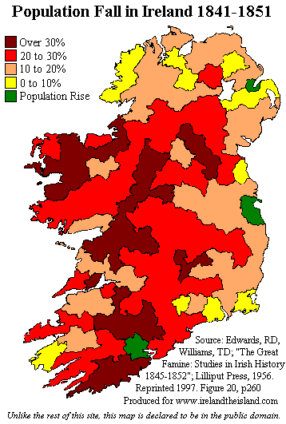
Why did they come here? Where did they settle?
Why they came here?
Germans – farmers looking for land
Irish – Potato Famine (1840s) “Black Forties”
Settled in large cities in the Northeast
Boston and New York
Where did they settle?
Germans – on the frontier and the Midwest and Northwest
Ohio, Wisconsin, etc.
Kindergarten

Slide 4
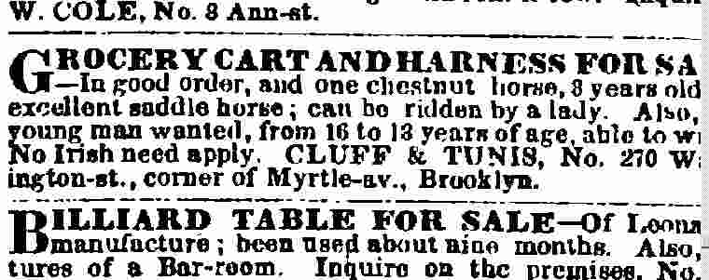

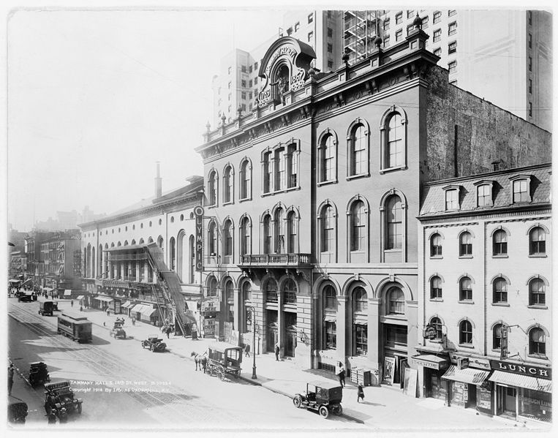
Nativism
What is it?
Fear, distrust, and hatred of foreigners
Reasons for nativism:
Different cultures
Different languages
Religion
Irish and Germans “stole” elections
Tended to vote Democratic
Tammany Hall – NYC
Immigrants “took” jobs
Work for less money
Would not unionize

Slide 5
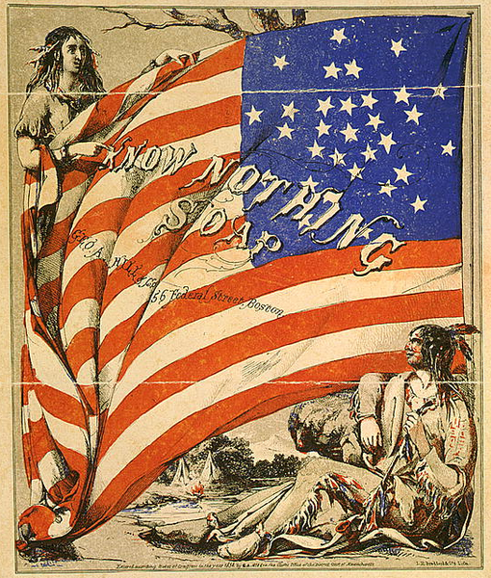
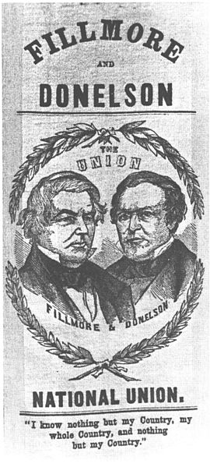
The “Know-Nothing” Party
What is it?
Political party formed due to nativism
Originated as the Supreme Order of the Star-Spangled Banner
Wanted to ban Catholics from holding offices
Called for tougher immigration and naturalization laws
In 1856, Ex-President Millard Fillmore ran for President the Know-Nothing Party
Won 21% of the popular vote
By 1860, they were no longer a political threat

Slide 6
Thanks for watching!
Subscribe to my channel
Help spread the word
Questions? Comments? Ideas for videos?
Leave in comments
Don’t be a Know-Nothing when it comes to APUSH knowledge, Subscribe!
Subscribe
Down here!

